Slide 1


Grating light valve Technology
Submitted BY:
M.SAI ESWAR,
18A31A0447,
ECE-B,
Pragati Engineering College.

Slide 2

contents
Introduction.
Working.
Fabrication.
Applications.
Comparing.
Advantages.
Conclusion.

Slide 3
Introduction _______________________________________
The Cathode Ray Tube TV set has ruled the consumer electronics world for decades. Now a days every one wants big screens for their entertainment rooms. But bigger a CRT screen, the glass tube will be deeper and the set becomes impossibly heavy and unwieldy when the diagonal measurement of the screen goes beyond about 36 inches.
All of us must have noted the red color of the hero's suit in the movie 'spiderman', the blues of the sky and water scenes were captivating. The dark horse technology behind this is GRATING LIGHT VALVE TECHNOLOGY (GLV).
The original GLV device concepts were developed at Stanford University. Later Silicon Light Machines was found in 1994 to develop and commercialize a range of products based on this technology.
The GLV device is a type of optical micro electromechanical system or MEMS essentially a movable, light reflecting surface created directly on a silicon wafer, utilizing standard semiconductor processes and equipment.

Slide 4
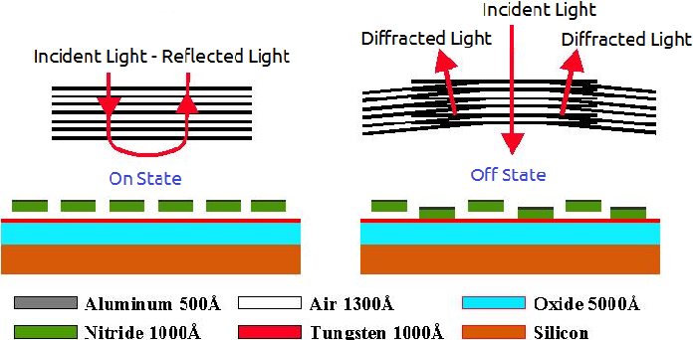
WORKING _______________________________________________
A Grating Light Value (GLV) device consists of parallel rows of reflective ribbons. Alternate rows of ribbons can be pulled down approximately one-quarter wavelength to create diffraction effects on incident light.
When all the ribbons are in the same plane, incident light is reflected from their surfaces.
By blocking light that returns along the same path as the incident light, this state of the ribbons produces a dark spot in a viewing system.

Slide 5
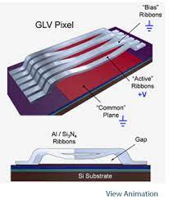
WORKING _______________________________________________
When the (alternate) movable ribbons are pulled down, however, diffraction produces light at an angle that is different from that of the incident light. Unblocked, this light produces a bright spot in a viewing system.
The Grating Light Valve uses reflection and diffraction to create dark and bright image areas.

Slide 6
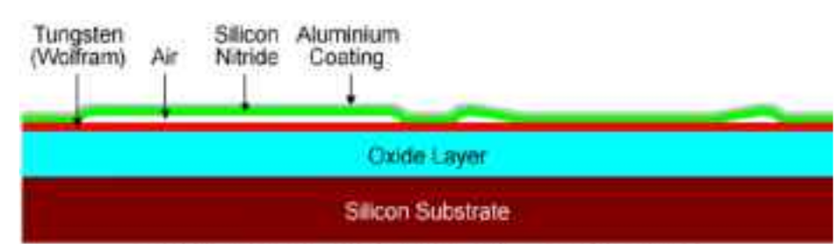
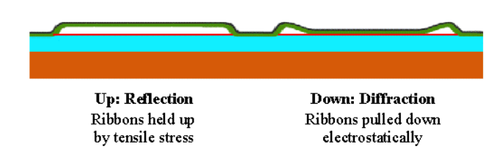
FABRICATION _______________________________________
On the left the ribbon is in its rest position
On right ,the ribbon has been pulled down by an electrostatic charge.

Slide 7
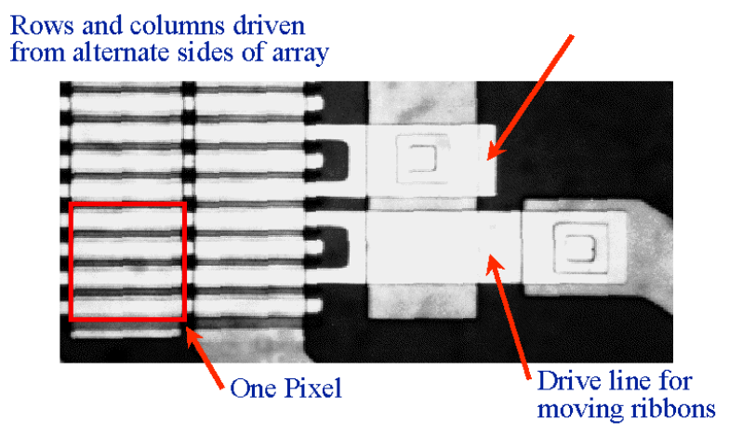
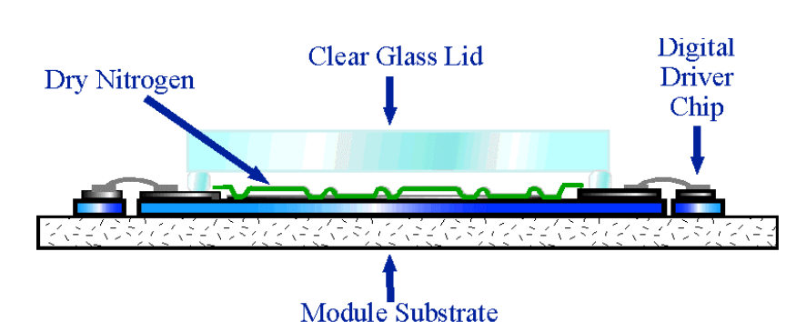
In one implementation which Silicon Light Machines has built, the ribbon lengths are 20 µm, and the ribbon pitch is 5 µm. The pull-down distance is approximately 1300 Angstroms, or approximately onequarter wavelength of green light. With these dimensions, a set of four ribbons produces a 20 µm square pixel.

Slide 8
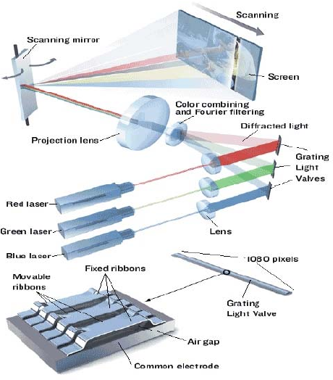
Applications __________________________________________
The GLV technology has been applied to a wide range of products, from laser-based HDTV sets to computer-to-plate offset printing presses to DWDM components used for wavelength management.
Grating Light Valve based image acquisition and projection display system.

Slide 9
COMPARING
Compared to its closest alternative — micro-mirror light valve technology — the GLV device is much simpler to fabricate, requiring only 7 mask steps.
GLV devices use smaller, lighter, mechanical structures that move through smaller excursions than alternative light-valve technologies. Hence, it is faster, requires less external memory and no transistors in the MEMS array.
As GLV devices are built using mainstream IC fabrication technology, ribbon dimensions are easily scaled allowing the production of smaller, lower-cost, devices with higher resolution and fill ratios.
Their small size makes it practical to build over a million pixels in a 1.3 inch diagonal. Coupled with their mass producibility, this makes the GLV a candidate for building high-resolution, low-cost displays.

Slide 10
ADVANTAGES ______________________________________
Interface is simple.
Because GLV devices are built using mainstream IC fabrication technology, ribbon dimensions are easily scaled allowing the production of smaller, lower-cost, devices with higher resolution and fill ratios.
High switching speed.
Low power consumption and cost.
Less weight and size.

Slide 11
CONCLUSION __________________________________________
The Grating Light Valve technology offers unique performance among spatial light modulator technologies. Particularly compelling are its extremely fast switching speed, its ability to be addressed in an analog fashion, and its ability to withstand very high optical power densities.
These attributes can be exploited to achieve a novel projection display architecture, which in turn offers a number of system cost and performance advantages over conventional projection display systems that are based on either 2-D spatial light modulators or scanned point systems.
Several aspects of the Scanned Linear GLV Architecture have been presented, along with a description of results achieved to date, by a relatively small team, working on laboratory prototype systems, using mostly off-the-shelf optical components.
Sony owns the exclusive rights to producing video display based on Grated light valve technology.

Slide 12


